Slide 1




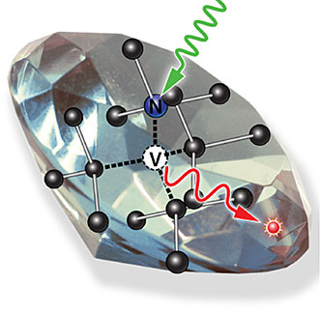
Spin Dynamics Simulation In NV Centre Diamond

Slide 2
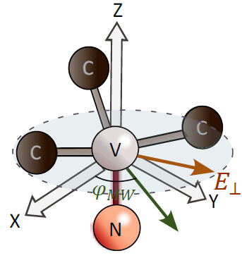
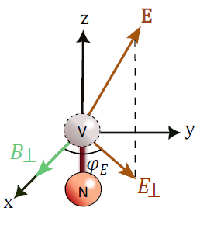


Theoretical Background
What is NV ensemble ?
Thousands or millions of NV centres clustered together in a crystal diamond lattice.
What is multipartite System ?
Multipartite System: multiple distinct components or parties.
For an NV Centre:
Party 1: electronic spin triplet
Party 2: nuclear spin of host ¹⁴N atom (I=1) or ¹⁵N atom (I=1/2)
Party 3: nuclear spins of nearby ¹³C atoms (I=1/2)
Who do we use NV ensemble ?
Detecting weak fields but over a larger area as compared to single NV centre.
Improved SNR
N : Number of NV centres
: Minimum detectable field strength
MF and EF direction
Laura A. Volker et. al., SimOS: A Python Framework for Simulations of Optically Addressable Spins, arXiv:2501.05922v1 [quant-ph] 10 Jan 2025

Slide 3
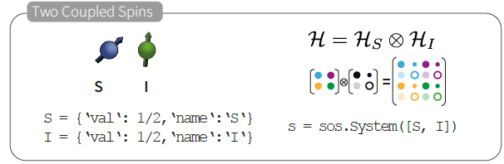
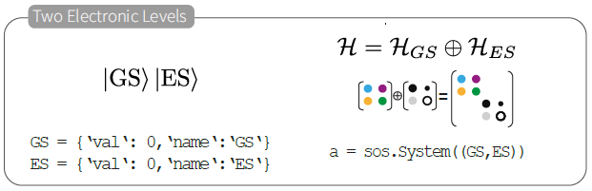
System Construction
What is Hilbert Space ?
Vector Space containing all physically allowable quantum states (state vectors) of a quantum system.
Mathematical operations:
Tensor Product as Lists
Direct Sum as Tuples
Tensor or Kronecker Product
[Coupled Spin Pair]
First spin level : Colour
Second spin level : Shape
Each state of H_{S} coexists with each and every state of H_{I}
Direct Sum
[Pair of electronic energy levels]
Ground energy level : Colour
Excited energy level : Shape
Stacking of separate states in different energy levels.
Laura A. Volker et. al., SimOS: A Python Framework for Simulations of Optically Addressable Spins, arXiv:2501.05922v1 [quant-ph] 10 Jan 2025

Slide 4

Theoretical Background
What are Eigen States ?
Stable and naturally existing states under the given Hamiltonian.
From Linear Algebra: Mv = λv
M : Matrix
v : Eigen vector
λ : Eigen value
In the context of NV centre:
: Hamiltonian matrix
: Eigenstate or Spin State
: Energy eigenvalue
Eigen value same Energy of state same
Yuchun Zhu et. al., Simulation of ODMR Spectra from NV Ensembles in Diamond for EF Sensing, arXiv:2301.04106v1 [quant-ph] 10 Jan 2023

Slide 5


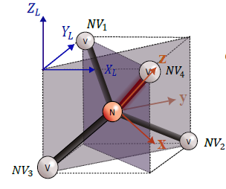

Ground State Spin Hamiltonian
What is Hamiltonian Operator ?
Linear operator on a Hilbert Space that describes total energy of a physical system.
Ground State Spin Hamiltonian of NV Centre
: Nuclear Spin Hamiltonian
: Electronic Spin Hamiltonian
The nuclear spin Hamiltonian is due to the hyperfine interaction between NV electron spin and nitrogen nuclear spin.
All these Hamiltonians are 9x9 matrices whose eigen values are allowed energy levels of the system.
NV Reference Frame
Z-axis is along NV symmetry axis.
X-axis is one of the defect’s three symmetry planes.
Fields are decomposed into parallel and transverse components with respect to NV axis.
Static Hamiltonian
NV Reference Frame and Lab Frame
Yuchun Zhu et. al., Simulation of ODMR Spectra from NV Ensembles in Diamond for EF Sensing, arXiv:2301.04106v1 [quant-ph] 10 Jan 2023

Slide 6
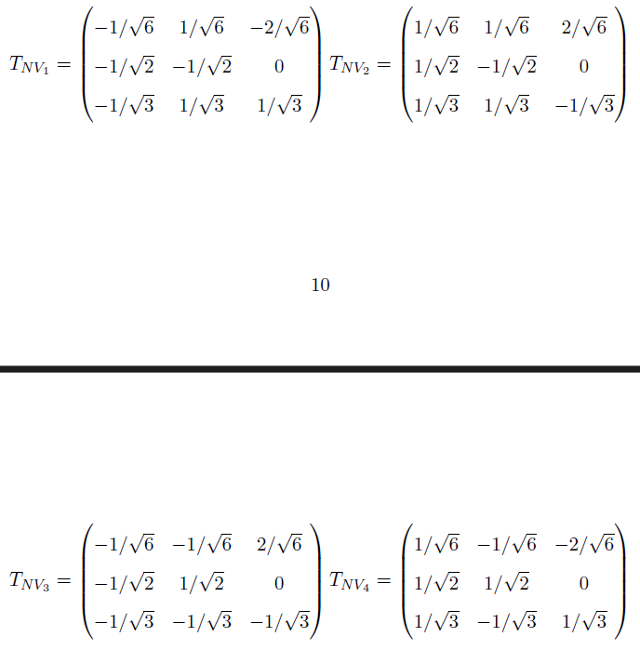
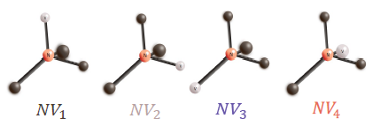
Frame Transformation
Rotation matrix for Lab frame to NV frame transformation
NV Reference Frame and Lab Frame
4 possible NV orientations in diamond crystal lattice
Yuchun Zhu et. al., Simulation of ODMR Spectra from NV Ensembles in Diamond for EF Sensing, arXiv:2301.04106v1 [quant-ph] 10 Jan 2023

Slide 7
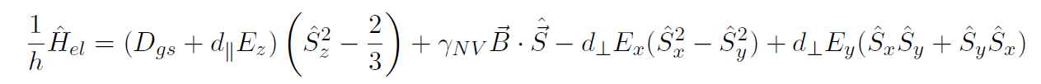





Ground State Spin Hamiltonian
Electronic Spin Hamiltonian
= 2.87 GHz : Temperature dependent Zero field splitting
: Electronic gyromagnetic ratio
: Parallel EF coupling strength
: Transverse EF coupling strength
: Total electronic spin operator
Static Hamiltonian
(Time invariant)
is about 50 times larger than
Larger sensitivity to EF component
perpendicular to NV axis
Yuchun Zhu et. al., Simulation of ODMR Spectra from NV Ensembles in Diamond for EF Sensing, arXiv:2301.04106v1 [quant-ph] 10 Jan 2023

Slide 8







Ground State Spin Hamiltonian
Static Hamiltonian
(Time invariant)
Nuclear Spin Hamiltonian
: Nuclear quadrupole parameter
: Nuclear gyromagnetic ratio
: Axial magnetic hyperfine parameter
: Transverse magnetic hyperfine parameter
: Total nuclear spin operator
The nuclear quadrupole interaction is only for nuclei with total spin I>=1
N
is about 9000 times larger than
So sometimes nuclear term can be ignored for simplified results
Yuchun Zhu et. al., Simulation of ODMR Spectra from NV Ensembles in Diamond for EF Sensing, arXiv:2301.04106v1 [quant-ph] 10 Jan 2023

Slide 9



Ground State Spin Hamiltonian
Dynamic Hamiltonian
(Time varying)
MW Interaction Hamiltonian
: Linewidth or Full Width at Half Maximum (FWHM)
: Nuclear gyromagnetic ratio
: Electronic gyromagnetic ratio
: Total electronic spin operator
: Total nuclear spin operator
The interaction Hamiltonian induces transition from initial eigen state to final eigen state.
Dirac Notation:
: Ket
: Bra
N
The states and are determined by eigen values of
Magnetic Dipole Transition Probability
* Apply to
* Inner product the result with
* is Hermitian of
* Square the modulus of entire term
Yuchun Zhu et. al., Simulation of ODMR Spectra from NV Ensembles in Diamond for EF Sensing, arXiv:2301.04106v1 [quant-ph] 10 Jan 2023

Slide 10
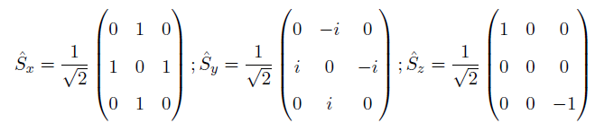
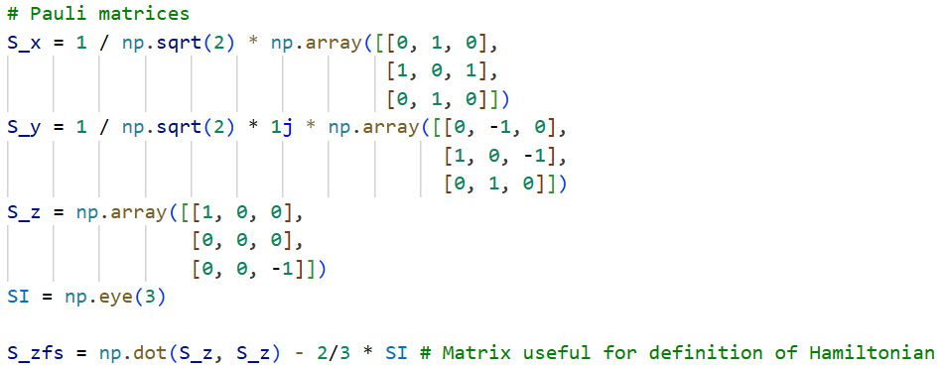
Pauli Spin Matrices
Since ¹⁴N nucleus is a spin-1(I=1) system so and are same
3x3 identity matrix
Yuchun Zhu et. al., Simulation of ODMR Spectra from NV Ensembles in Diamond for EF Sensing, arXiv:2301.04106v1 [quant-ph] 10 Jan 2023

Slide 11
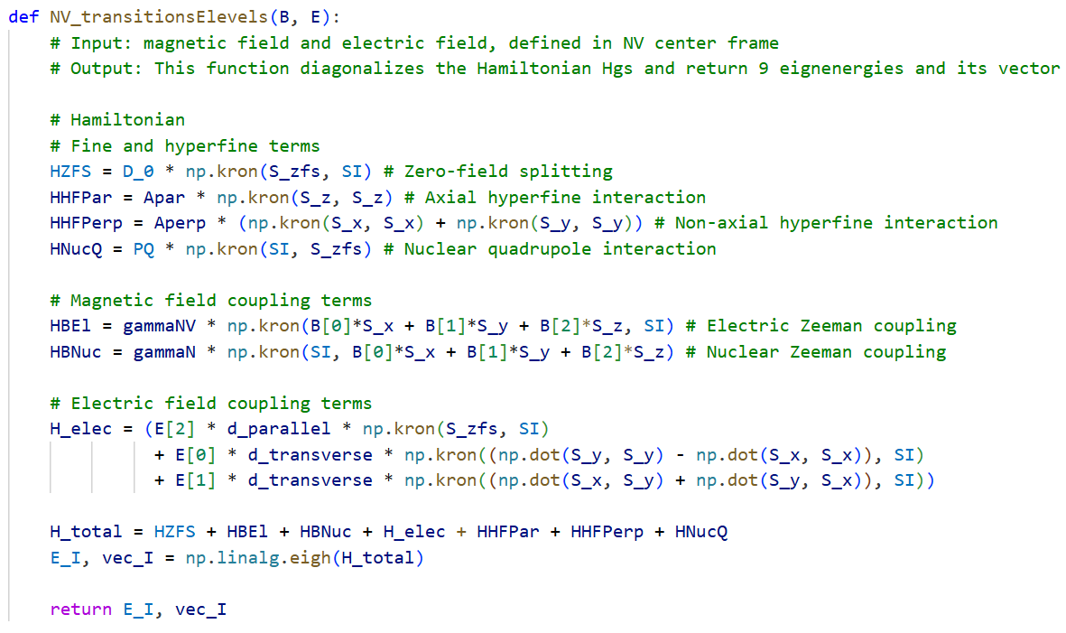
Hamiltonian Calculation
Yuchun Zhu et. al., Simulation of ODMR Spectra from NV Ensembles in Diamond for EF Sensing, arXiv:2301.04106v1 [quant-ph] 10 Jan 2023

Slide 12
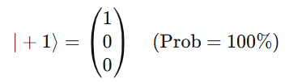
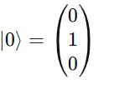
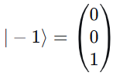
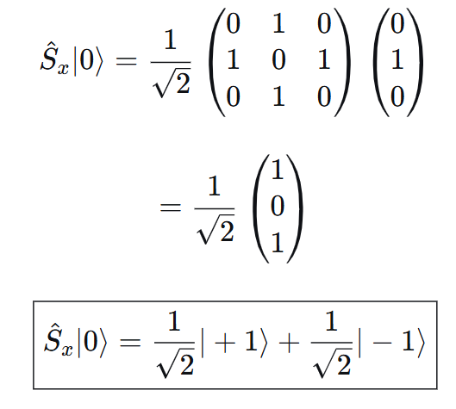
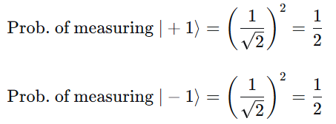

Ground State Spin Hamiltonian
NV Spin Basis States (Spin-1 System)
Creation of Quantum Superposition
NV e- are in state
MF is absent.
Transverse EF is absent.
MW signal with MF component along x-axis is applied. ( )
Quantum Superposition Transient State
Yuchun Zhu et. al., Simulation of ODMR Spectra from NV Ensembles in Diamond for EF Sensing, arXiv:2301.04106v1 [quant-ph] 10 Jan 2023

Slide 13
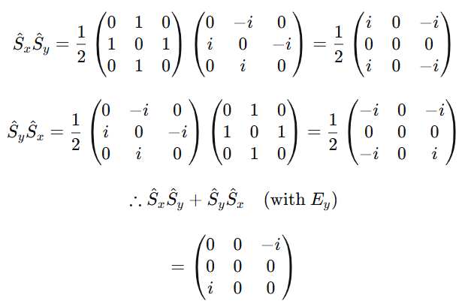
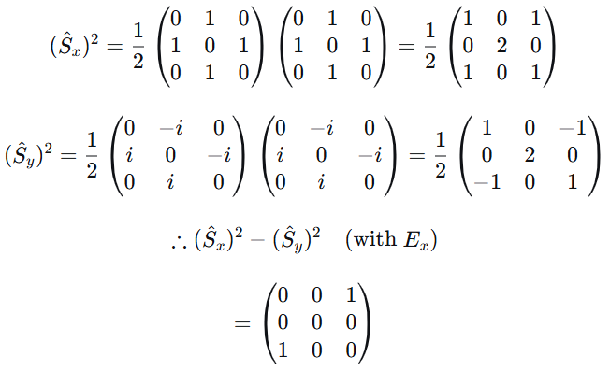

Transverse Electric Field
from
to
Mixing occurs only when two states are degenerate.
Transverse EF causes mixing of the and states.
The transverse EF does not interfere with state. No transitions to or from it.
E_{x} mixes the and states perfectly in x direction while E_{y} mixes them in y direction.
Yuchun Zhu et. al., Simulation of ODMR Spectra from NV Ensembles in Diamond for EF Sensing, arXiv:2301.04106v1 [quant-ph] 10 Jan 2023

Slide 14

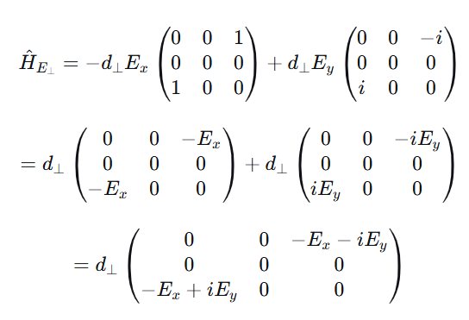
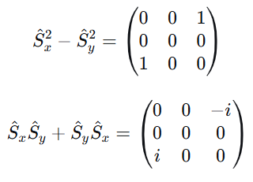
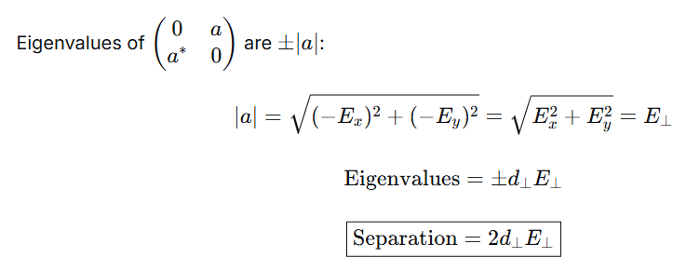
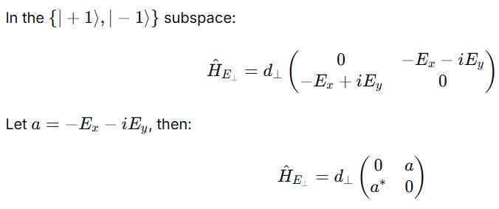
Transverse EF
Yuchun Zhu et. al., Simulation of ODMR Spectra from NV Ensembles in Diamond for EF Sensing, arXiv:2301.04106v1 [quant-ph] 10 Jan 2023

Slide 15
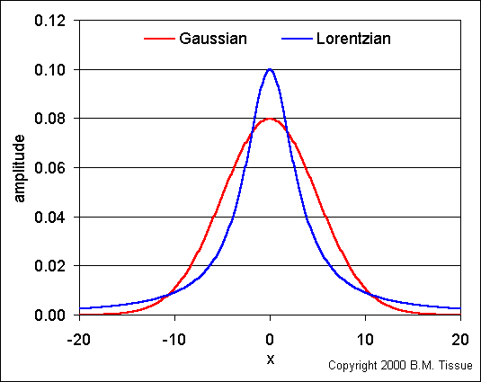
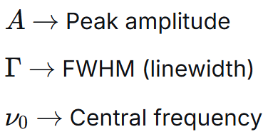
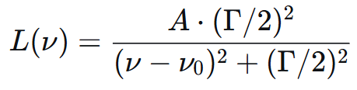
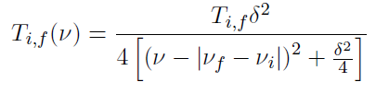

Ground State Spin Hamiltonian
Lorentzian Function
This transition has Lorentzian shape.
Frequency dependent transition amplitude is given as:
Nature of Gaussian v/s Lorentzian curve
Total Transition Strength :
* Summing over all possible initial and final states
* T is proportional to ODMR contrast
Yuchun Zhu et. al., Simulation of ODMR Spectra from NV Ensembles in Diamond for EF Sensing, arXiv:2301.04106v1 [quant-ph] 10 Jan 2023

Slide 16
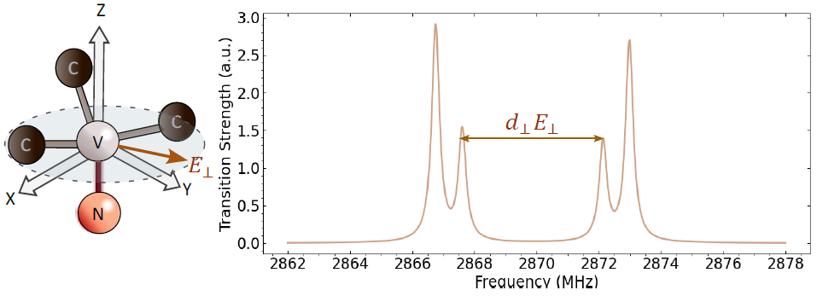

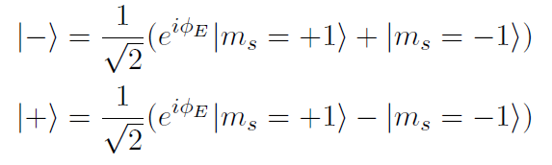
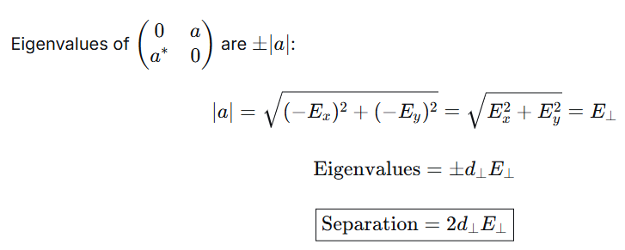
Transverse EF
m_{I} = -1
m_{I} = +1
m_{s} = 0 to -1
m_{s} = 0 to -1
m_{I} = +1
m_{s} = 0 to -
m_{s} = 0 to +
m_{I} = -1
m_{s} = 0 to +1
m_{I} = 0
m_{I} = 0
m_{s} = 0 to +1
2
$$φ_{E}$$
Mixing of states due to transverse EF (MW is unpolarized)
Transverse EF mixes the degenerate states with m_{I} = 0
The mixed states are also split by an amount and their spins point in the x-y plane.
Yuchun Zhu et. al., Simulation of ODMR Spectra from NV Ensembles in Diamond for EF Sensing, arXiv:2301.04106v1 [quant-ph] 10 Jan 2023

Slide 17

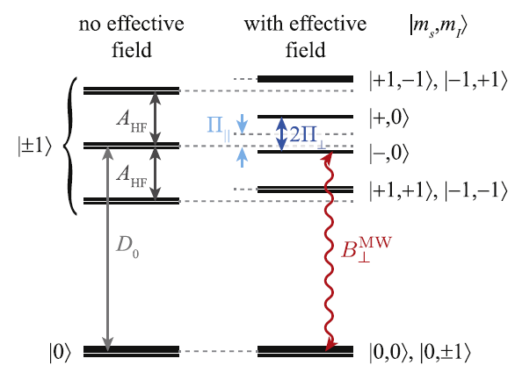




Axial And Transverse EF
: Axial hyperfine parameter
: Axial/Parallel EF
: Transverse/Perpendicular EF
Axial EF causes an equal amount of shift in the m_{s}=+/-1 states wrt m_{s}=0
The nuclear quadrupole interaction is not taken into account here.
Energy Level Diagram of NV ground state in absence of MF
Transverse EF mixes the degenerate states with m_{I} = 0
The mixed states are also split by an amount and their spins point in the x-y plane.
J Kolbl et. al., New J. Physics, 2019, 113039

Slide 18
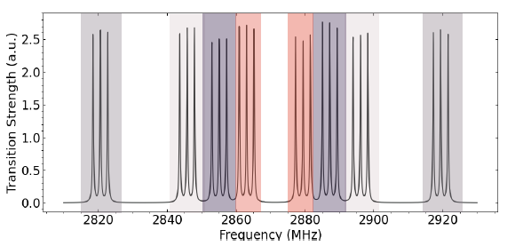
Transition Strength
m_{s} = 0 to -1
m_{s} = 0 to +1
4 possible NV orientations in diamond crystal lattice
Transition strength spectrum at B = 18G
Yuchun Zhu et. al., Simulation of ODMR Spectra from NV Ensembles in Diamond for EF Sensing, arXiv:2301.04106v1 [quant-ph] 10 Jan 2023

Slide 19
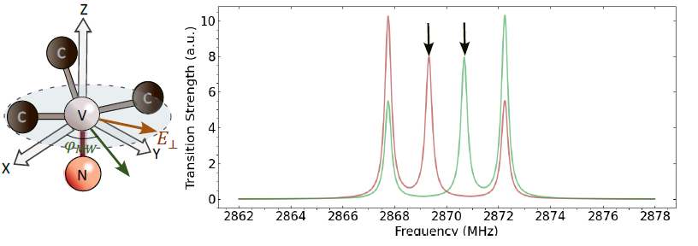

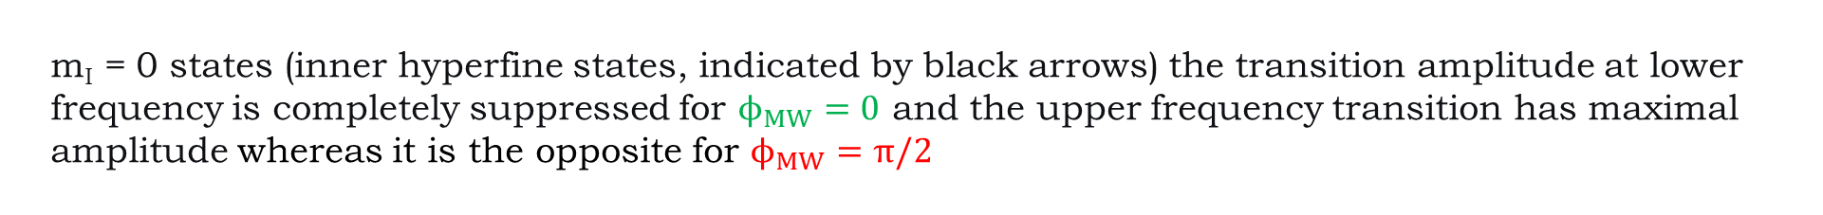

Mw Polarization
m_{s}=0 to -
m_{s}=0 to +
m_{I} = +1
m_{I} = -1
m_{I} = 0
m_{I} = 0
m_{I} = +1
m_{I} = -1
m_{s}=0 to +1
m_{s}=0 to -1
m_{s}=0 to -1
m_{s}=0 to +1
$$φ_{MW}=π/2$$
$φ_{MW}=0$
$$φ_{E}=180°$$
Transition Strength spectrum for two different MW linear polarizations
m_{I}​ = 0 states (inner hyperfine states, indicated by black arrows) the transition amplitude at lower frequency is completely suppressed for $ϕ_{MW}=0$ and the upper frequency transition has maximal amplitude whereas it is the opposite for $ϕ_{MW}=π/2$
Yuchun Zhu et. al., Simulation of ODMR Spectra from NV Ensembles in Diamond for EF Sensing, arXiv:2301.04106v1 [quant-ph] 10 Jan 2023

Slide 20


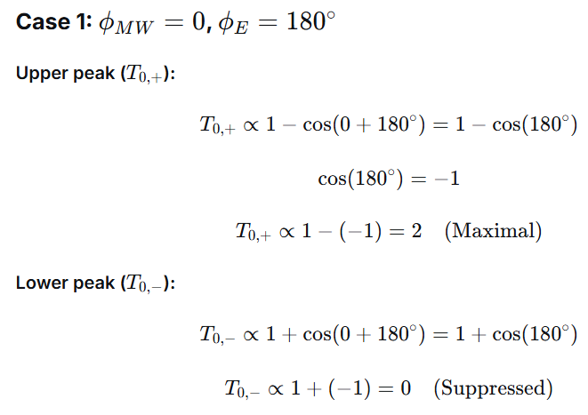
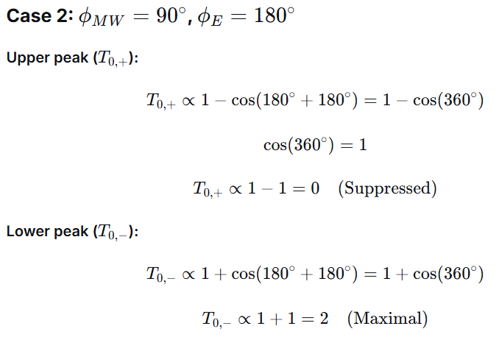
Transition Strength
Transition strength from m_{s} = 0 to mixed states due to transverse EF and linearly polarized MW signal.
J Kolbl et. al., New J. Physics, 2019, 113039

Slide 21

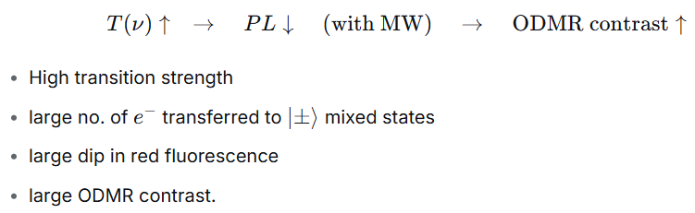
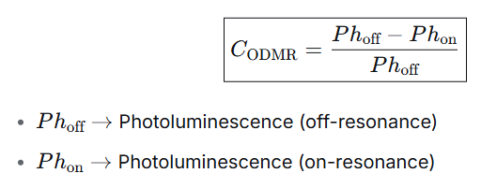
ODMR Contrast
Transition strength from m_{s} = 0 to mixed states due to transverse EF and linearly polarized MW signal .
Transition Strength is proportional to ODMR contrast in low magnetic field regime (B < 100G).
Photoluminescence can be measured using Photodiode.
Xuan Phuc Le et. al., Field effect detected magnetic resonance of NV centre in diamond, https://doi.org/10.1038/s44172-025-00541-z

Slide 22
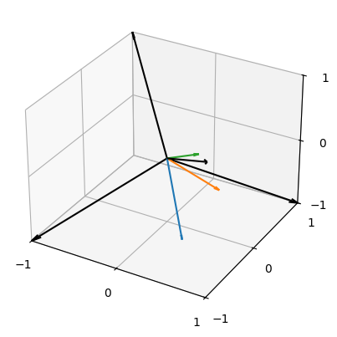
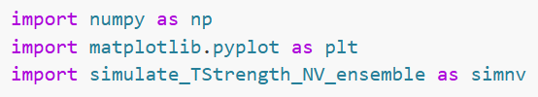
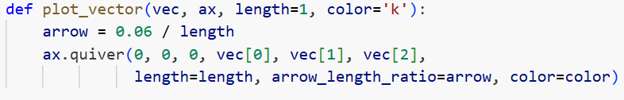
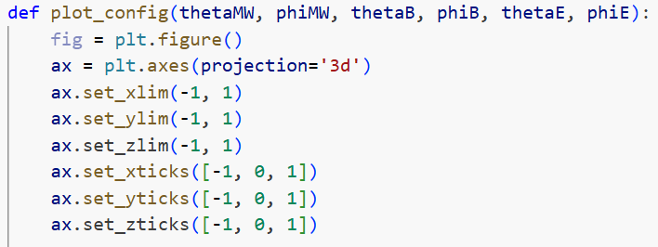
Odmr Spectra Simulation
Core Libraries
: Numerical operations
: Plots and Figures
: Custom calculations
3D Vector generator
: Generating arrow vectors
: Arrow tip size
Diamond Lattice 3D Canvas
: 3D plot with axes ranging from -1 to +1
4 NV orientations and EF,MF and MW vectors
Yuchun Zhu et. al., Simulation of ODMR Spectra from NV Ensembles in Diamond for EF Sensing, arXiv:2301.04106v1 [quant-ph] 10 Jan 2023

Slide 23
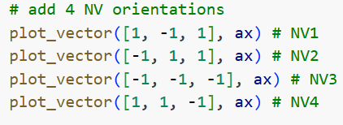
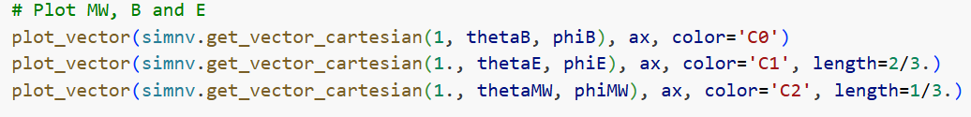
Odmr Spectra Simulation
Crystal Lattice Orientation
MF, EF and MW Vector Plot
4 NV orientations and EF,MF and MW vectors
Yuchun Zhu et. al., Simulation of ODMR Spectra from NV Ensembles in Diamond for EF Sensing, arXiv:2301.04106v1 [quant-ph] 10 Jan 2023

Slide 24
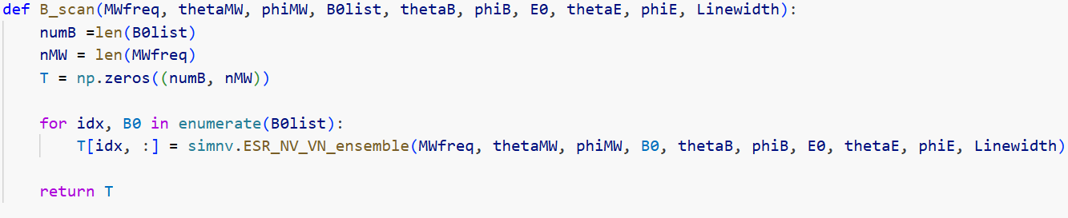
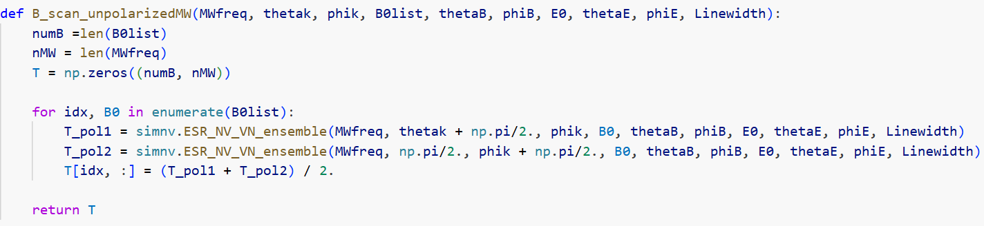
Odmr Spectra Simulation
Transition Strength for Linearly Polarized MW
2D array with Rows = MF values
Columns = MW frequencies
For each MF, transition strength considering all 4 NV orientations and both NV/VN configurations is calculated
Transition Strength for Unpolarized MW
Statistical average of 2 linearly polarized MW signals gives unpolarized MW
For each MF, transition strength considering all 4 NV orientations and both NV/VN configurations is calculated
Yuchun Zhu et. al., Simulation of ODMR Spectra from NV Ensembles in Diamond for EF Sensing, arXiv:2301.04106v1 [quant-ph] 10 Jan 2023

Slide 25
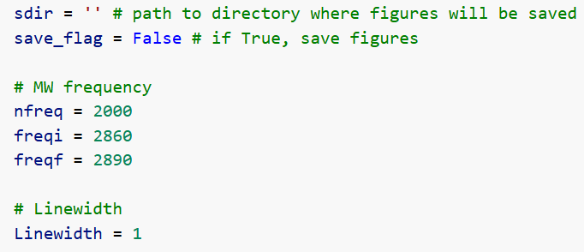
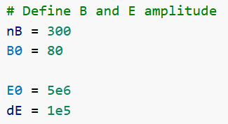
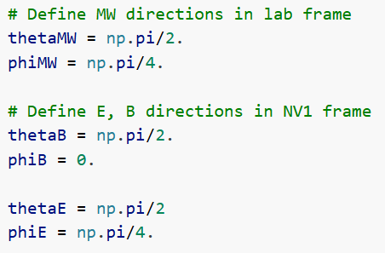

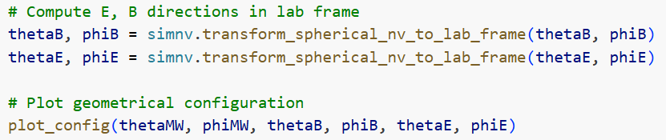

Odmr Spectra Simulation
Data Resolution Limits
Magnitude Parameters
2000 MW frequencies points centred around resonance point f_{o} = 2.87 GHz
300 MF values from 0 to 80G
E = 5 x 10⁶ V/m
dE = 1 x 10⁵ V/m
FWHM
Multi Frame Vector Coordinates
Frame Rotation
NV1 frame to Lab Frame conversion
Yuchun Zhu et. al., Simulation of ODMR Spectra from NV Ensembles in Diamond for EF Sensing, arXiv:2301.04106v1 [quant-ph] 10 Jan 2023

Slide 26



Odmr Spectra Simulation
Run Simulation
Creates linearly spaced arrays for MW frequencies and MF strength
Computes ODMR spectrum map for all (B,MW) combinations at E=E₀ and E=E₀+dE
Raw ODMR Valleys
Shows heat map of transition strength as a function of MF and MW frequency
Transition Strength v/s MF
Yuchun Zhu et. al., Simulation of ODMR Spectra from NV Ensembles in Diamond for EF Sensing, arXiv:2301.04106v1 [quant-ph] 10 Jan 2023

Slide 27
Conclusions
Low Field (B=0): Several faintly crowded horizontal lines start around 2.87 GHz. These correspond to the ZFH transitions of all 4 NV orientations.
Medium Field (B<40G): Zeeman splitting separates the NV orientations leading to 24 resolved branches.
High Field (B>40G): The inner and outer transitions begin to merge due to their non-zero linewidth.
The main bright branch which starts around 2871 MHz at 30G
and curves upto 2885 MHz at 80G corresponds to one of the m_{s}=0 -> -1
transition for an NV family that is most weakly aligned with the MF.
Transition Strength v/s MF
Supplementary material by T. Mittiga et. al., Imaging the Local Charge Environment of NV Centre in diamond, 10.1103/PhysRevLett.121.246402

Slide 28



Odmr Spectra Simulation
Calculates the electrical sensitivity of NV centre using a
differential map
Differential Electrometry
Layout Compression Formatting
Electric Field Sensitivity v/s MF
Ensures that labels, ticks and colour bar fit properly
without being cut
Yuchun Zhu et. al., Simulation of ODMR Spectra from NV Ensembles in Diamond for EF Sensing, arXiv:2301.04106v1 [quant-ph] 10 Jan 2023

Slide 29


Conclusions
Sensitivity:
Black (+ve ΔS): Transition strength decreases as EF increases.
Red (-ve ΔS): Transition strength increases as EF increases.
Low Field (B=0): All 4 NV orientations are degenerate. Monotonically increasing sensitivity with MF.
Medium Field (B~30G): The sensitivity doesn’t drop to 0 unlike single NV case.
High Field (B~60G):
The Zeeman splitting dominates and the 3 hyperfine lines merge into single unresolved line.
Maximal sensitivity is obtained and it saturates.
The chosen MW direction allows to selectively excite only the lower frequency transition with TS twice as in unpolarized case.
Electric Field Sensitivity v/s MF
Supplementary material by T. Mittiga et. al., Imaging the Local Charge Environment of NV Centre in diamond, 10.1103/PhysRevLett.121.246402

Slide 30

Odmr Spectra Simulation
Shows maximum positive and negative sensitivity as a function of MF
Sensitivity Plot
Image File Export
: Saving the plots if intended
Optimal Values of Sensitivity
Yuchun Zhu et. al., Simulation of ODMR Spectra from NV Ensembles in Diamond for EF Sensing, arXiv:2301.04106v1 [quant-ph] 10 Jan 2023

Slide 31
Conclusions
Sensitivity:
Black (+ve ΔS): Transition strength decreases as EF increases.
Red (-ve ΔS): Transition strength increases as EF increases.
Low Field (B=0): Both curves show jagged, noisy behaviour. The sensitivity here is unreliable.
Medium Field (B<40G): Hyperfine structure is still resolved so 3 distinct hyperfine lines. Sensitivity is diluted because the changes in multiple overlapping transitions partially cancel out.
High Field (B>40G): The Zeeman splitting dominates and the 3 hyperfine lines merge into single unresolved line. Optimal sensing is achieved at B=60-80G where the contrast is highest.
: maximum sensitivity
: minimum sensitivity
Optimal Values of Sensitivity
Supplementary material by T. Mittiga et. al., Imaging the Local Charge Environment of NV Centre in diamond, 10.1103/PhysRevLett.121.246402

